Slide 1
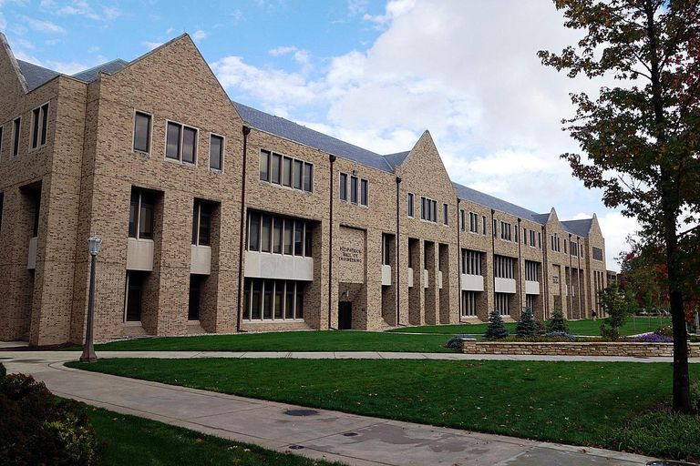
Lecture 00 – Introduction to Computer Architecture
1
Dr. Matthew Morrison
Assistant Teaching Professor
University of Notre Dame
January 15, 2024

Slide 2
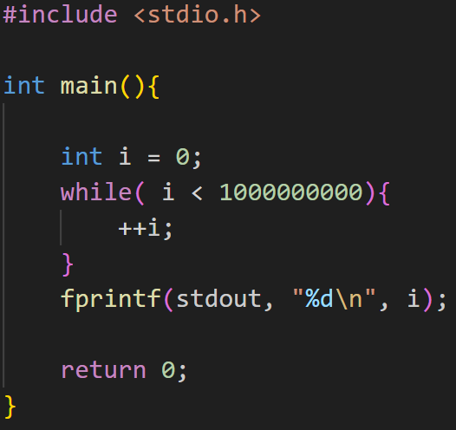
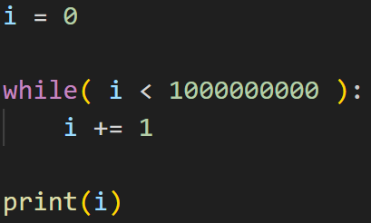
An Introductory Case Study
Let’s compare the run time of a while loop counting to 1,000,000,000
C vs Python
What do you think will happen?

Slide 3
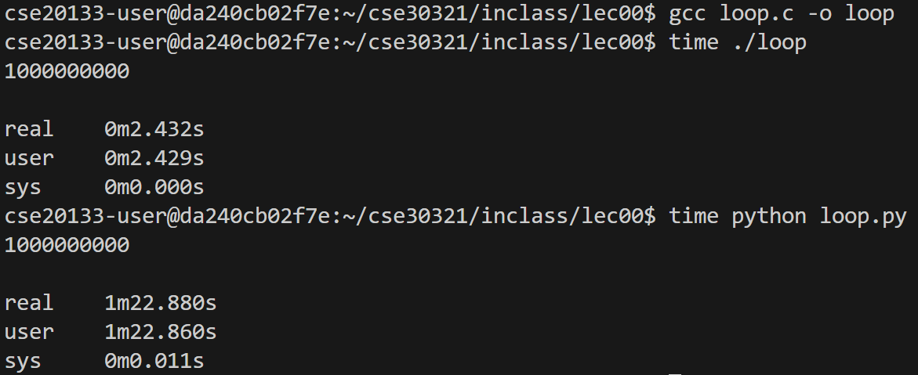
Time Comparison

Slide 4
Think, Pair, and Share
When would you want to use Python in your programming?
When would you want to use C in your programming?

Slide 5
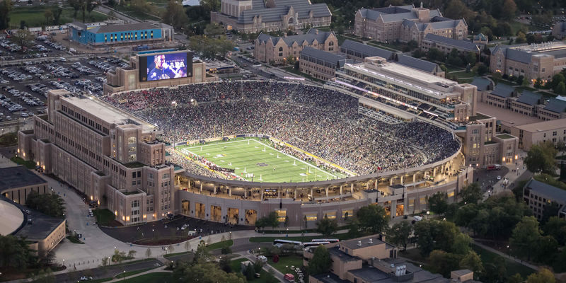

Abstractions in Programming
Hackers attack Casino’s fish tank thermometer to obtain sensitive data

Slide 6

Scooter Computer and Mr. Chips

Slide 7
A look under the hood
Let’s look at what happens when we generate assembly language
gcc –S loop.c
python –m dis loop.py
C runs directly in the local machine architecture
Python runs in the Virtual Machine

Slide 8
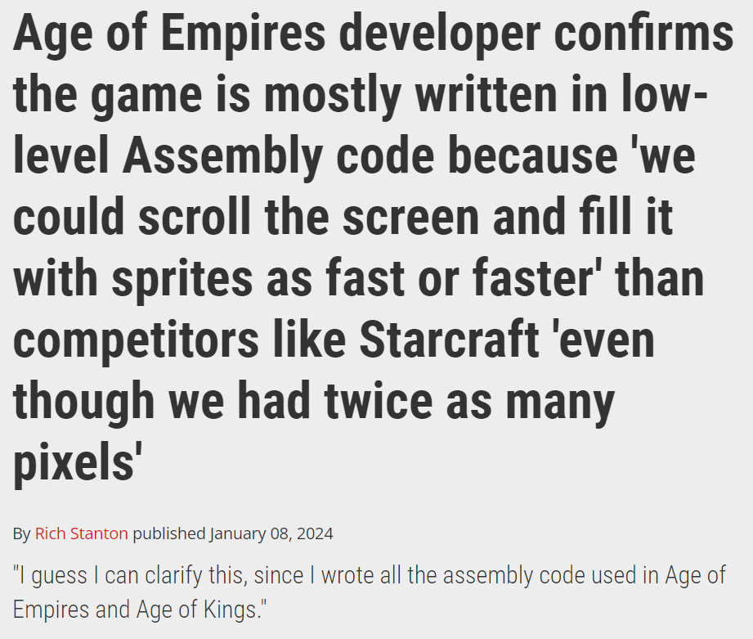
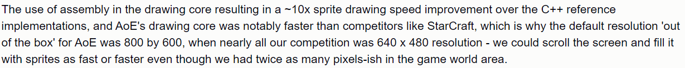
In the News
Source

Slide 9
Why Computer Architecture?
What are your current opinions on this course?
Why do you think you are taking this class?
Let’s put all these thoughts on the board

Slide 10
What is Computer Architecture?
Story Time: Intel interview
Definitions
Computer Architecture – System attributes of a computer that contribute to its logical execution and are visible to the programmer
Computer Organization – Physical details of a computer that are transparent to the programmer
In the future
Problem 1 on HW 1, Exam 1, and the Final Exam
“Define and differentiate between computer architecture and computer organization”

Slide 11
Computer Architecture Catalog Description
Introduction to basic architectural concepts that are present in current scalar machines, together with an introduction to assembly language programming, computer arithmetic, and performance evaluation.
Commercial computer-aided-design software is used to deepen the student's understanding of the top-down processor design methodology. MIPS-based assembly language will be used.

Slide 12

Course Information
CSE 30321 – Computer Architecture
Required for CS and CPEG majors
TuTh - 11-12:15pm in DeBartolo Hall 116
Canvas Page
https://canvas.nd.edu/courses/82217

Slide 13
Textbook
CSE 30321 Computer Architecture zyBook
Sign in or create an account at https://learn.zybooks.com
Enter zyBook code: NDCSE30321MorrisonSpring2024
Subscribe. Cost is $97 for the semester.
Course Slack
https://app.slack.com/client/T0HJVP8MS/C06DND1TLBY
LinkedIn
https://www.linkedin.com/in/gregariousmatt/

Slide 14
Office Hours
My Office Hours in 178 Fitzpatrick Hall
M, Tu, W – 1-2pm
Th 1-3pm
Or by Appointment
TA Office Hours on Google Calendar
TA hours start in Week 2

Slide 15
Reading
15 Reading Assignments worth 100 points each
Most due on Tuesday at 11am at the beginning of each week
First Reading Assignment due this Thursday at 11am
Get ahead of any issues, start back in the studying habit
Let’s look at Lecture Notes and Schedule and the Reading outline

Slide 16
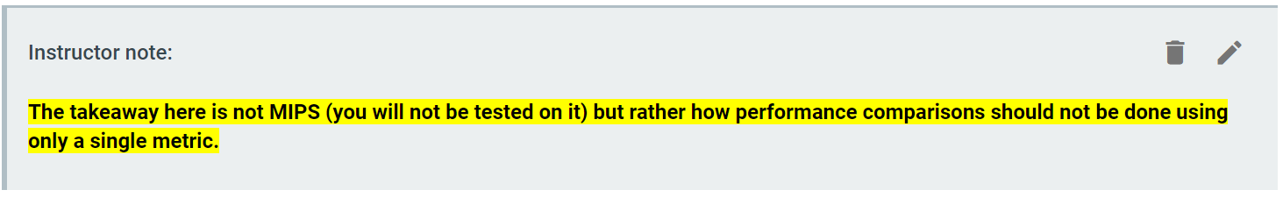
zyBook
Warning: readings may be longer than in Logic Design
Chapters tend to be longer, as do sections
Keep an eye out for “Instructor Notes”:
Occasionally, these will call out sections that you can skip and still receive full credit for the reading:
Sections marked optional may still be of interest

Slide 17
Homework Assignments

Slide 18
Three Exams
Three Exams

Slide 19

A Good Place to Discuss AI and Coding
An old calculator gives insight into a new problem…

Slide 20

A Good Place to Discuss AI and Coding
Someday, AI may be able to reliably develop engineering-quality code

Slide 21

Unicorn Chaser: Last Minute!
What it’s like for the Professor when there is exactly one minute left in Lecture
Instagram Artist:
@jakekrantz
Source: https://www.instagram.com/p/CQPMA4qAMht/

